Slide 1
Java JDBC
Instructor :Prashant Mishra
BIAS Bhimtal

Slide 2
Java JDBC
JDBC stands for Java Database Connectivity. JDBC is a Java API to connect and execute the query with the database. It is a part of JavaSE (Java Standard Edition). JDBC API uses JDBC drivers to connect with the database. There are four types of JDBC drivers:
JDBC-ODBC Bridge Driver,
Native Driver,
Network Protocol Driver, and
Thin Driver

Slide 3
Why Should We Use JDBC
Before JDBC, ODBC API was the database API to connect and execute the query with the database. But, ODBC API uses ODBC driver which is written in C language (i.e. platform dependent and unsecured). That is why Java has defined its own API (JDBC API) that uses JDBC drivers (written in Java language).
We can use JDBC API to handle database using Java program and can perform the following activities:
Connect to the database
Execute queries and update statements to the database
Retrieve the result received from the database.

Slide 4
What is API
API (Application programming interface) is a document that contains a description of all the features of a product or software. It represents classes and interfaces that software programs can follow to communicate with each other. An API can be created for applications, libraries, operating systems, etc.

Slide 5
JDBC Product Components
JDBC includes four components:
The JDBC API — The JDBC™ API provides programmatic access to relational data from the Java™ programming language. Using the JDBC API, applications can execute SQL statements, retrieve results, and propagate changes back to an underlying data source. The JDBC API can also interact with multiple data sources in a distributed, heterogeneous environment.
The JDBC API is part of the Java platform, which includes the Java™ Standard Edition (Java™ SE ) and the Java™ Enterprise Edition (Java™ EE). The JDBC 4.0 API is divided into two packages: java.sql and javax.sql. Both packages are included in the Java SE and Java EE platforms.
JDBC Driver Manager — The JDBC DriverManager class defines objects which can connect Java applications to a JDBC driver. DriverManager has traditionally been the backbone of the JDBC architecture. It is quite small and simple.
The Standard Extension packages javax.naming and javax.sql let you use a DataSource object registered with a Java Naming and Directory Interface™ (JNDI) naming service to establish a connection with a data source. You can use either connecting mechanism, but using a DataSource object is recommended whenever possible.

Slide 6
JDBC Test Suite — The JDBC driver test suite helps you to determine that JDBC drivers will run your program. These tests are not comprehensive or exhaustive, but they do exercise many of the important features in the JDBC API.
JDBC-ODBC Bridge — The Java Software bridge provides JDBC access via ODBC drivers. Note that you need to load ODBC binary code onto each client machine that uses this driver. As a result, the ODBC driver is most appropriate on a corporate network where client installations are not a major problem, or for application server code written in Java in a three-tier architecture.

Slide 7
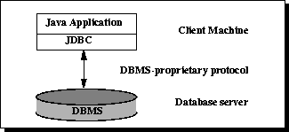
JDBC Architecture
two-tier and Three-tier Processing Models
The JDBC API supports both two-tier and three-tier processing models for database access.
In the two-tier model, a Java applet or application talks directly to the data source. This requires a JDBC driver that can communicate with the particular data source being accessed. A user's commands are delivered to the database or other data source, and the results of those statements are sent back to the user. The data source may be located on another machine to which the user is connected via a network. This is referred to as a client/server configuration, with the user's machine as the client, and the machine housing the data source as the server. The network can be an intranet, which, for example, connects employees within a corporation, or it can be the Internet.

Slide 8
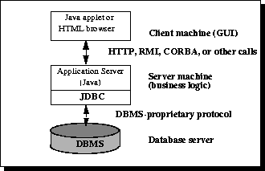
In the three-tier model, commands are sent to a "middle tier" of services, which then sends the commands to the data source. The data source processes the commands and sends the results back to the middle tier, which then sends them to the user. MIS directors find the three-tier model very attractive because the middle tier makes it possible to maintain control over access and the kinds of updates that can be made to corporate data. Another advantage is that it simplifies the deployment of applications. Finally, in many cases, the three-tier architecture can provide performance advantages.
Figure 2: Three-tier Architecture for Data Access.

Slide 9
JDBC Driver
JDBC Driver is a software component that enables java application to interact with the database. There are 4 types of JDBC drivers :
JDBC-ODBC bridge driver
Native-API driver (partially java driver)
Network Protocol driver (fully java driver)
Thin driver (fully java driver)

Slide 10
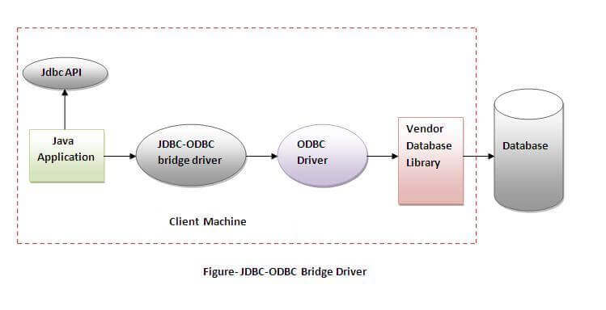
1) JDBC-ODBC bridge driver
The JDBC-ODBC bridge driver uses ODBC driver to connect to the database. The JDBC-ODBC bridge driver converts JDBC method calls into the ODBC function calls. This is now discouraged because of thin driver.

Slide 11
Oracle does not support the JDBC-ODBC Bridge from Java 8. Oracle recommends that you use JDBC drivers provided by the vendor of your database instead of the JDBC-ODBC Bridge.
Advantages:
easy to use.
can be easily connected to any database.
Disadvantages:
Performance degraded because JDBC method call is converted into the ODBC function calls.
The ODBC driver needs to be installed on the client machine.

Slide 12
2) Native-API driver
The Native API driver uses the client-side libraries of the database. The driver converts JDBC method calls into native calls of the database API. It is not written entirely in java .
Advantage:
performance upgraded than JDBC-ODBC bridge driver.
Disadvantage:
The Native driver needs to be installed on the each client machine.
The Vendor client library needs to be installed on client machine.

Slide 13
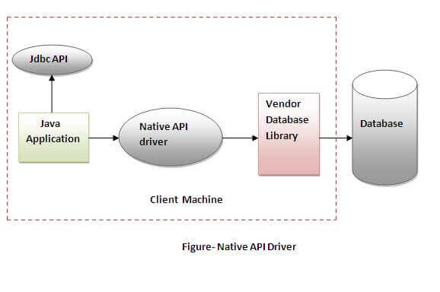

Slide 14
3) Network Protocol driver
The Network Protocol driver uses middleware (application server) that converts JDBC calls directly or indirectly into the vendor-specific database protocol. It is fully written in java.
Advantage:
No client side library is required because of application server that can perform many tasks like auditing, load balancing, logging etc.
Disadvantages:
Network support is required on client machine.
Requires database-specific coding to be done in the middle tier.
Maintenance of Network Protocol driver becomes costly because it requires database-specific coding to be done in the middle tier.

Slide 15
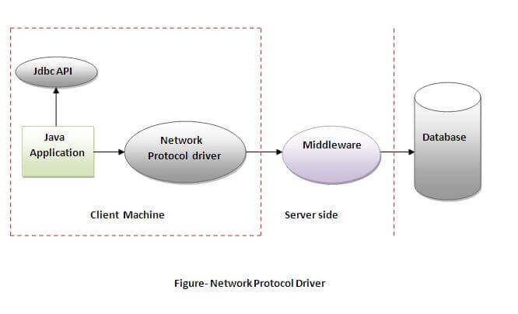

Slide 16
4) Thin driver
The thin driver converts JDBC calls directly into the vendor-specific database protocol. That is why it is known as thin driver. It is fully written in Java language.
Advantage:
Better performance than all other drivers.
No software is required at client side or server side.
Disadvantage:
Drivers depend on the Database.

Slide 17
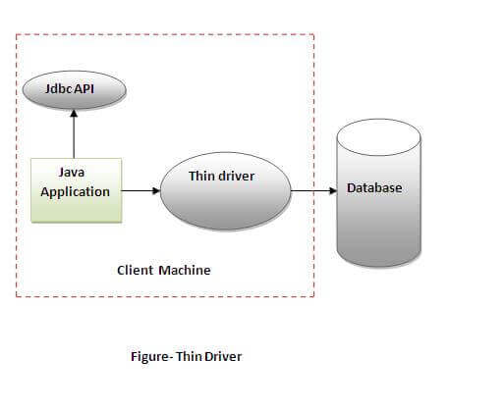

Slide 18
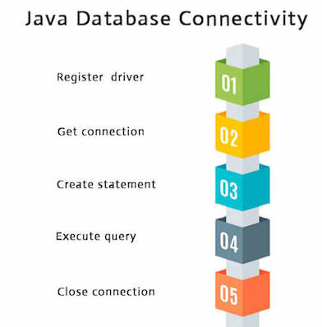
Java Database Connectivity with 5 Steps
There are 5 steps to connect any java application with the database using JDBC. These steps are as follows :
Register the Driver class
Create connection
Create statement
Execute queries
Close connection

